Slide 1
Responsive Design
Front-End Web Development

Slide 2
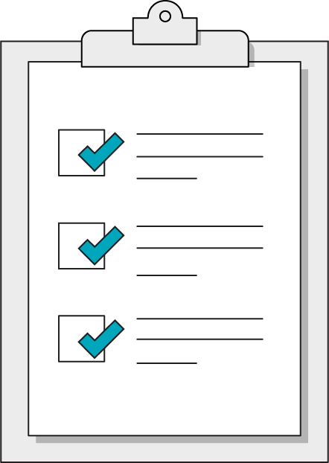
Today’s Learning Objectives
In this lesson, you will:
Define media query breakpoints to apply separate rules based on screen size.
Use responsive measurements such as ems to smoothly scale CSS rules to devices.
Apply a mobile-first methodology to CSS and website design.
‹#› | © 2020 General Assembly

Slide 3
Responsive Design and
Media Queries
Front-End Web Development

Slide 4
A Bit of Background
The iPhone, unveiled in 2007, changed how people used the internet. It took until ~2009 to become popular.
This was first addressed by creating mobile-specific sites (started with m.site.com), which meant you had to make multiple sites! Yuck.
As browsers evolved, it became possible (by 2010) to build one site where you could adjust styles based on screen widths, creating one site for all devices.
Ethan Marcotte pioneered this technique with an article on the subject: http://alistapart.com/article/responsive-web-design.

Slide 5

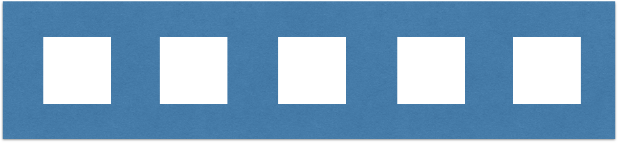
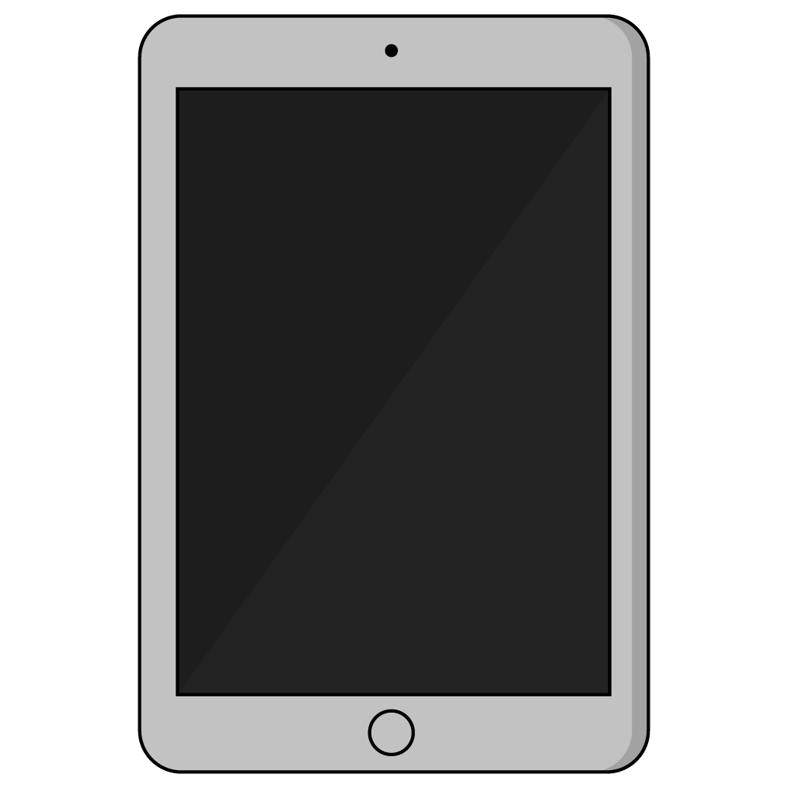
Why?
Laptops/desktops have horizontal orientations.
Designers can place several elements next to each other with plenty of room.

Slide 6
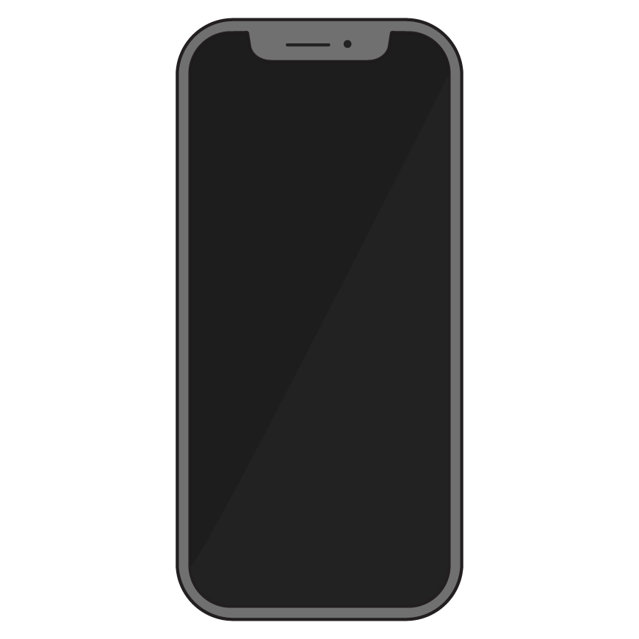
Why? (Cont.)
Tablet/mobile phones have vertical orientations.
Content should rely on having many rows of one item each. There’s not enough room for more!

Slide 7



Good Mobile Design: FTC.gov
Desktop
Mobile

Slide 8
Screen Sizes
Think about device widths and CSS cascading. How would we target these?
iPhone SE/iPhone 5S = 320px
Galaxy/iPhone 6 = 380px - 400px
iPhone 6+, Galaxy Note = 420px
Phablet/tablet = 500px–650px
iPad/iPad mini = 768px
Laptops = 960px–1200px
Desktops = 1024px–1800px

Slide 9
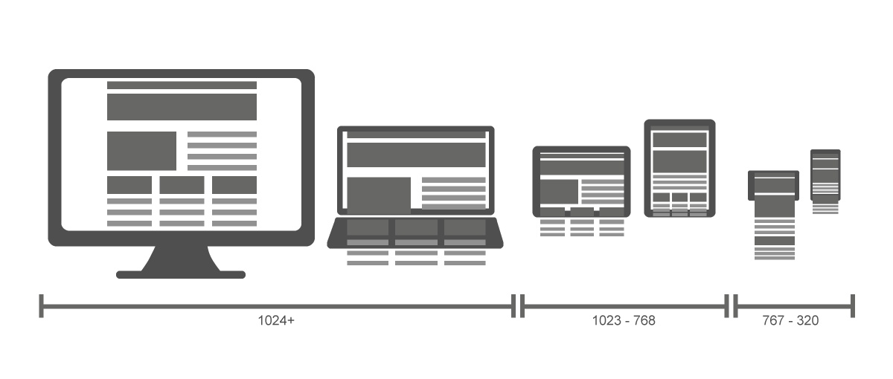
Device Grouping

Slide 10

Device Grouping
Phones
Tablets
Laptops & Desktops
iPhone SE/iPhone 5S = 320px
Galaxy/iPhone 6 = 380px– 400px
iPhone 6+/Galaxy Note = 420px
Phablet/tablet = 500px–650px
iPad/iPad mini = 768px
Laptops = 960px–1200px Desktop = 1024px–1800px

Slide 11
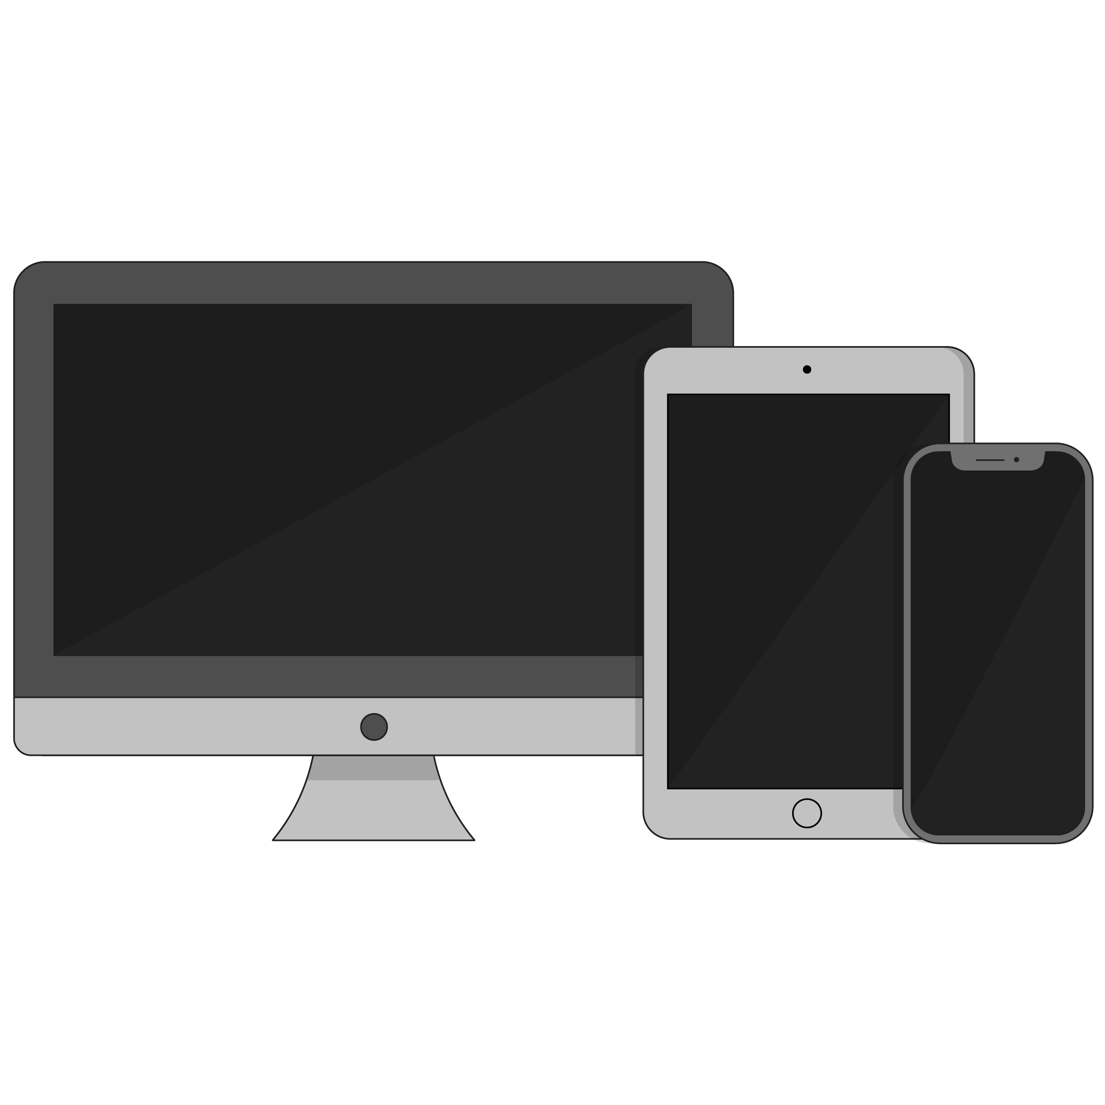
Good Breakpoints
480 pixels // phones
768 pixels // tablets
960 pixels // small screens
1200 pixels // big screens
Target your styles against these breakpoints (you can make others, but these are versatile).

Slide 12
Two Approaches to Responsive Design
Three Breakpoints: Mobile, Tablet, Desktop
Many Breakpoints: Component-based Breakpoints

Slide 13
Viewport
<meta name="viewport" content="width=device-width, initial-scale=1">
You have to tell the browser you want the page to be responsive. Include this code above the head. This tells the browser to scale the page to the device that’s viewing it.

Slide 14
@media Query
Syntax is a bit weird at first, though. You’ll potentially see @ rules for the first time in CSS (others exist: @import, @keyframes).
What does this code do? What is being targeted?
@media (min-width: 480px) {
.text-design {
font-size: 24px;
}
}

Slide 15
The Media Query
.text-design {
font-size: 18px;
}
@media (min-width: 480px) {
.text-design {
font-size: 24px;
}
}
Target a min-width with @media and provide property/value pairs inside of the current style sheet. The code really is this easy but there’s more to consider.

Slide 16
Mobile-First
In mobile-first design, styles start with mobile and cascade to larger screens. This is the preferred way of implementing responsive design, as mobile screens are harder to accommodate and design retroactively.
2
1
3

Slide 17
Thinking Time
Discussion
What are the pros and cons of each approach to breakpoints?

Slide 18
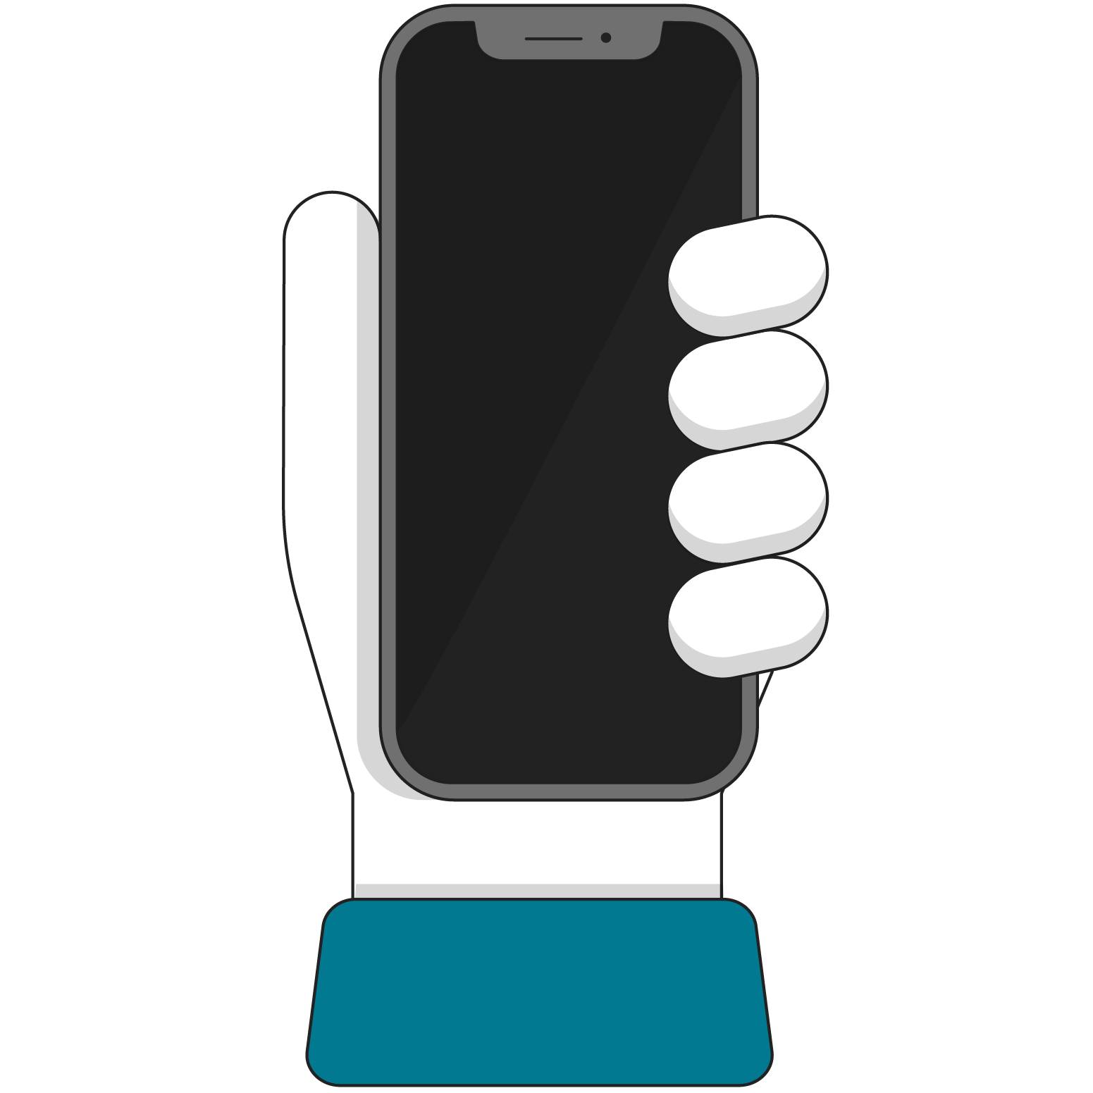
Using Media Queries With Layout
How you actually use media queries depends on your layout method. Generally, you’re adjusting both layout (flex, grid, etc.) and finish work (font, background, color).
First, let’s make the layout responsive!

Slide 19
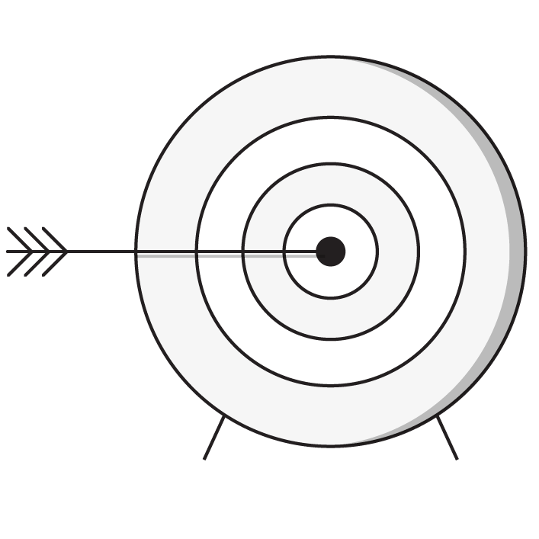
Targeting Non-Width Values
You can also tailor CSS around other attributes of the device that’s viewing your work. Things such as device type, screen resolution, and others are available but less common than width.
Here’s a full list of things you can target:
https://developer.mozilla.org/en-US/docs/Web/CSS/Media_Queries/Using_media_queries

Slide 20
Media Types
Typically, all you would use is the screen type. Many sites leave it out altogether now.
Media Type | Description
all | Suitable for all devices
print | Styles for printed documents
screen | Phones, tablets, TV, watches, computers
speech | Screen readers for accessibility

Slide 21
Media Features (abridged)
There are a handful of targetable features that we regularly use. There are a lot more that are almost never used.
Media Type | Description
width | Suitable for all devices
height | Styles for printed documents
orientation | Phones, tablets, TV, watches, computers

Slide 22
Compound Media Query With Type and Width
@media screen and (min-width: 480px) {
.my-class {
property: value;
}
}
Almost all devices register as screen, making this largely irrelevant, but you’ll see it in older codebases.
The only use case in which you see “type” in the wild is when making style sheets for documents that print (such as concert tickets or boarding passes). Even this use case is dying because of mobile apps that perform these tasks.

Slide 23
The Media Query
@media (min-width: 768px) and (max-width: 959px) {
.text-design {
font-size: 20px;
}
}
@media (min-width: 30rem) and (orientation: landscape) {
.text-design {
font-size: 18px;
}
}

Slide 24
Another Approach: Separate Responsive Style Sheets
<link rel="stylesheet" media="screen and (min-width: 1024px)" href="css/1024only.css">
Separate style sheets are rare but still valid.

Slide 25
Responsive Units and Typography
Front-End Web Development

Slide 26
em
.class-cool {
font-size: 2em;
}
em is a unit of measurement derived from print design (based on the size of “M,” which is the largest letter).
It’s a sizing unit based on a parent element's size.
If .class-cool is inside a container with font-size: 16px;, what size is the font in pixels?

Slide 27
Sensible Usage
Set a specific value in px on body:
Base other styles on it:
body {
line-height: 12px;
}
h1 { line-height: 2.5em; } // 30px
h2 { line-height: 2em; } // 24px

Slide 28
Thinking Through It
body {
font-size: 10px;
}
div {
height: 5em; // 50px
width: 3em; // 30px
margin: 0.5em; // 5px
border: 0.1em; // 1px
}
Like ALL units, you can use em’s for anything that requires a size.

Slide 29
Avoid ems Within ems!
<div class="container">
<h2>How big is this title?</h2>
</div>
body {
font-size: 10px;
}
div {
font-size: 1.6em; // 16px
}
h2 {
font-size: 1.1em; // 17.6px
padding: 0.55em; // 8.8px
margin: 0.2em; // 3.2px
}
ems can quickly become a tangled mess of fractions on fractions when nested elements are concerned.
The example to the right shows just how tricky they can get!

Slide 30
There is rarely a compelling reason to use EM but there is often good reason to use REM.
‹#› | © 2021 General Assembly

Slide 31
rem
.class-cool {
font-size: 2rem;
}
Not a band or a phase of sleep but rather root EM.
It fixes the parent inheritance problem of em: The sizing won't change depending on nesting (kind of like how percentages change based on parent but vh/vw do not).

Slide 32
rem
.class-cool {
font-size: 2rem;
}
REM is defined as equal to the font-size of the root element.
(this is almost always the body)

Slide 33
rem In Practice
/* Won’t change based on HTML nesting, still nasty at times */
body {
font-size: 12px;
}
div {
font-size: 1.6rem; // 19.2px
}
h2 {
font-size: 1.1rem; // 13.2px
padding: 0.55rem; // 6.6px
margin: 0.2rem; // 2.4px

Slide 34
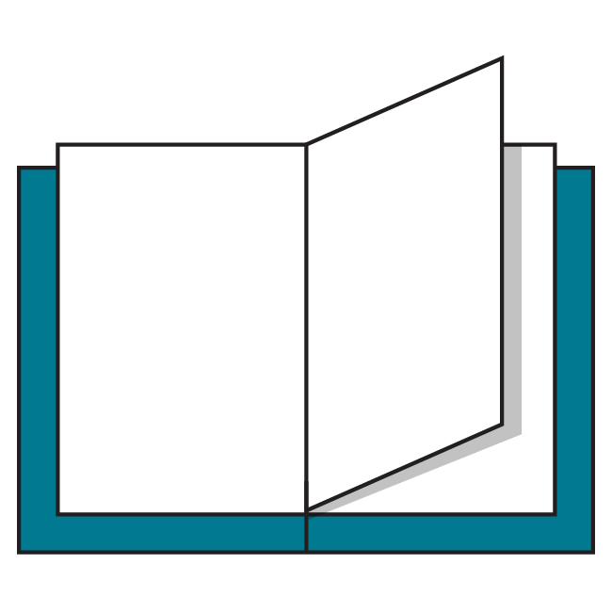
Additional Reading
Pixel + em + REM technique: https://css-tricks.com/rems-ems/
Pitfalls of em and REM, but everything can work given enough patience: http://zellwk.com/blog/rem-vs-em/

Slide 35
vh And vw Units
You can also use percentages of the viewport called vh and vw. There are 100 viewport height and 100 viewport width units per any screen you view (which is very similar to percentages!).
.container {
height: 100vh; /* full height of screen */
width: 50vh; /* half of width of screen */
}
Reference code:
https://drive.google.com/drive/folders/1gKVOGl6kqmerx156e_-LW1RVa6HEDycJ?usp=sharing

Slide 36
Percentages vs. vh/vw Units
The biggest difference? Nesting an element with percentage means it is bound by its parent. Viewport units will still be the same no matter how nested they are.
<section class=”container”>
<div class=”child-1”>Percent</div>
<div class=”child-2”>vw Units</div>
</section>
.child-1 {
width: 50% /* 50% of its parent */
}
.child-2 {
width: 50vw; /* 50% of the entire screen*/
}

Slide 37
Startup Matchmaker Member List
30–45 minutes
The Startup Matchmaker has built a member list but is not mobile-friendly. Let’s make it work at any size!
Starter code:
https://drive.google.com/drive/folders/1rqQMUXrbUDOaS5FEC_bQ1aOTzpuATnyj?usp=sharing
Solution code:
https://drive.google.com/drive/folders/1FOeHzIHcZ-cjs3ERpMSavZ7kYGL-oC3m?usp=sharing

Slide 38
Responsive Images
Front-End Web Development

Slide 39
Images Sized to Their Containers
.image-style {
display: block;
max-width: 100%;
height: auto;
}
Images want to display at their dimensions (say, 800 x 600px), but they’ll often be in containers and will spill over if they’re bigger. This code forces the image to be a block element whose width matches its container.
Why does this work?

Slide 40
HTML srcset + sizes Attributes
Figuring out which image should go to a particular device is cumbersome and nearly impossible. Now, you can tell the browser how much of the screen an image takes up (with the sizes attribute) and give it the image at different sizes (srcset). The browser does the rest.
Both sizes and srcset are attributes you can optionally add to any <img> tag you want to enable.

Slide 41
Code Sample: HTML srcset + sizes
<div class=”image-container”>
<img src=”img/image-large.jpg” alt=”Forest Lands”
srcset=”img/image-large.jpg 1200px,
img/image-medium.jpg 800px,
img/image-small.jpg 400px”
sizes=”(min-width: 1200px) 33vw,
(max-width: 1199px) and (min-width: 768px) 50vw,
100vw”>
</div>
The code is a doozy! We’re telling the browser we have three of the same image with various pixel widths, and then what size the image displays at a given screen width.

Slide 42
Responsive Background Images
.image-style {
background-image: url(img/image.jpg);
background-position: center center;
background-size: cover;
}
Background images are somewhat natively responsive; they won’t spill out of their containers. But containing elements will crop the image.
To adjust which part of the image you see, use background-position and background-size. In particular, background-size: cover; is pretty close to magic: It uses an algorithm to make the image match its container.

Slide 43
Responsive Image Investigation
Let’s see how a browser handles a responsive image.
Reference code:
https://drive.google.com/drive/folders/1H5wPU6aFhKSWGpimJp6-t3waBlkfNasx?usp=sharing

Slide 44
Responsive Navigation
Front-End Web Development

Slide 45
Add a Menu
30–45 minutes
Let’s keep building the Startup Matchmaker Member List. Add a menu AND make it mobile friendly by expanding and contracting with a hamburger icon.
Starter code:
https://drive.google.com/drive/folders/19w7bXlnJE-c5NW_4C7vlk4Yl7LAM-F5H?usp=sharing
Solution code:
https://drive.google.com/drive/folders/108K1sN_Z1CYIxk_EVF2kND_mG0xCOZja?usp=sharing

Slide 46
Key Takeaways
For Next Time
Mobile-First Development
The position Property
Using responsive units can ensure usable websites, regardless of device size.
It’s most effective to think about mobile screens first, then expand content for larger browsers.
We can use the position property to move elements around the page.

